Slide 1

AJAX-5
SHARMA COMPUTER ACADEMY

Slide 2
What is async/await?
The async and the await are 2 new keywords added to Javascript from ECMAScript 2017 i.e ES8.
They are basically used to simplify the way we write the code of Promise .
In simple words we can say that they make async code look more like synchronous code.

Slide 3
Introduction to async
The async keyword is used to write functions that handle asynchronous actions.
We wrap our asynchronous logic inside a function prepended with the async keyword.

Slide 4
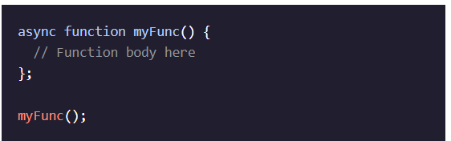
Async syntax
The async keyword provides extra information to the user of the function:
A. The function contains some Asynchronous Execution
B. The returned value will be the Resolved Value for the Promise.

Slide 5
Points to remember about return value
An async function will return in one of three ways:
If there’s nothing returned from the function, it will return a promise with a resolved value of undefined.
If there’s a non-promise value returned from the function, it will return a promise resolved to that value.
If a promise is returned from the function, it will simply return that promise.

Slide 6
Introduction to await
The async keyword by itself doesn’t do much.
Rather async functions are almost always used with the additional keyword await inside the function body.

Slide 7
Points to remember about await
await is an operator.
It is used just before the function call which is expected to return a Promise.
It returns the resolved value of a Promise.

Slide 8
Points to remember about await
However , the await keyword can only be used inside an async function.
Moreover since promises resolve in an indeterminate amount of time, the await operator halts, or pauses, the execution of our async function until a given promise is resolved.

Slide 9
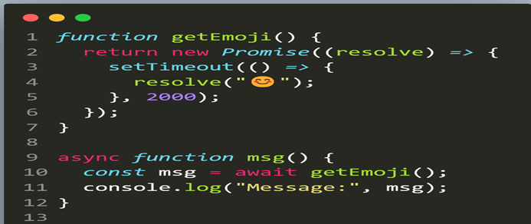
An example

Slide 10
Error handling with await
If a promise resolves, the await promise returns the result.
However, when the promise rejects, the await promise will throw an exception.
We can catch the exception by using the try...catch statement

Slide 11
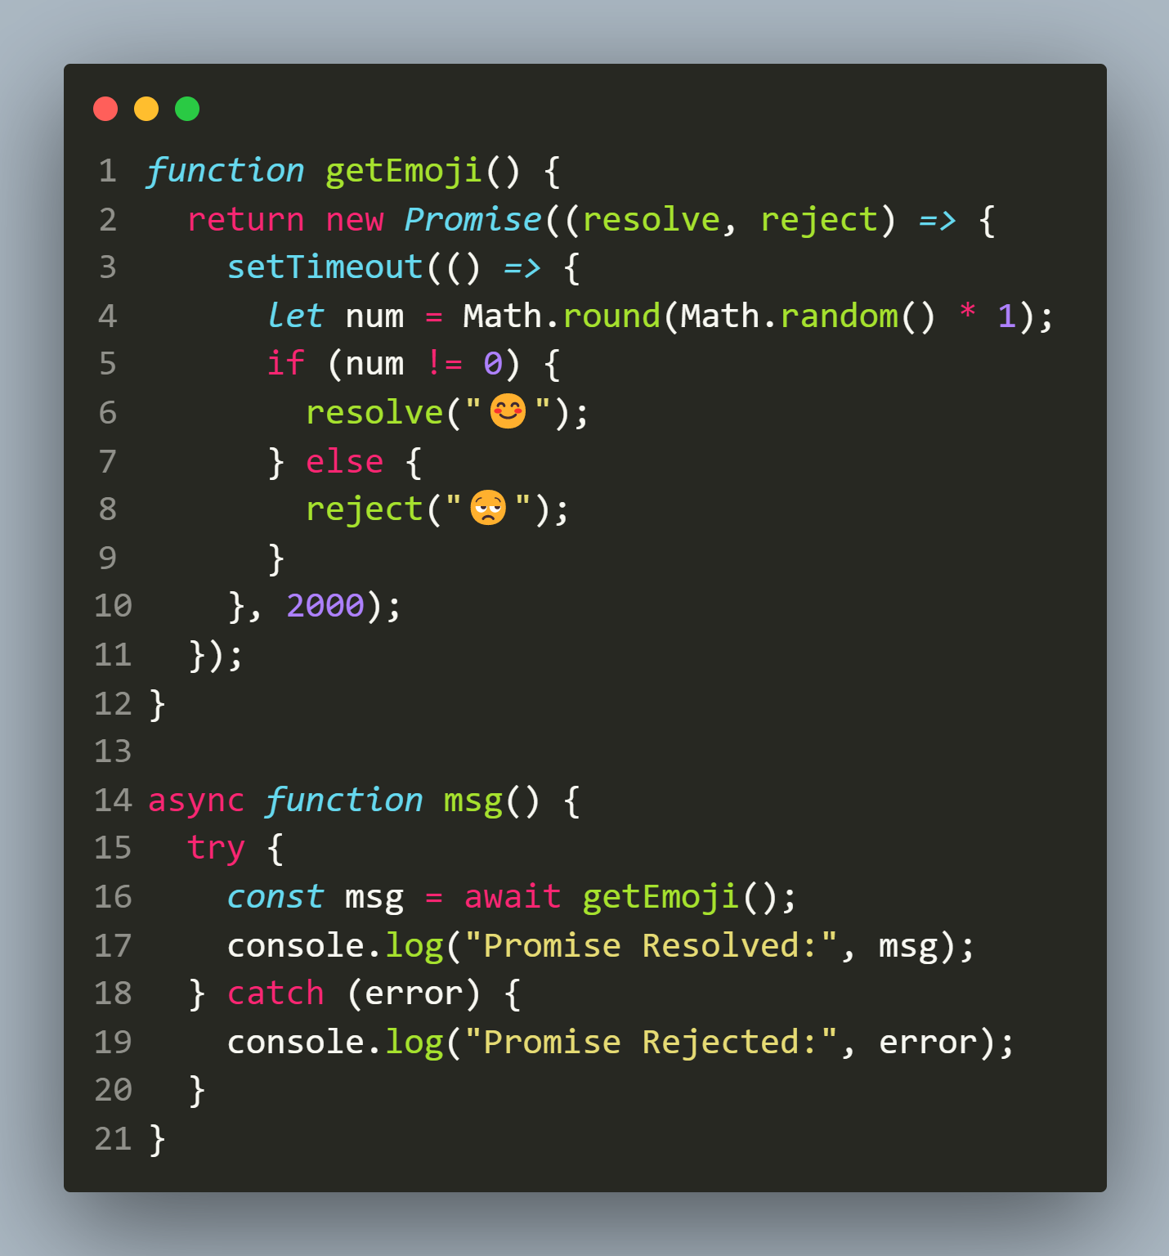
An example

Slide 12
Exercise 1
Rewrite the caclulateSquare application using async and
await keywords:

Slide 13
Promise chaining
The instance methods of the Promise object such as then(), catch(), or finally() return a separate promise object.
Therefore, we can call the promise’s instance method on the returned Promise.
The successively calling of methods in this way is referred to as the promise chaining.

Slide 14
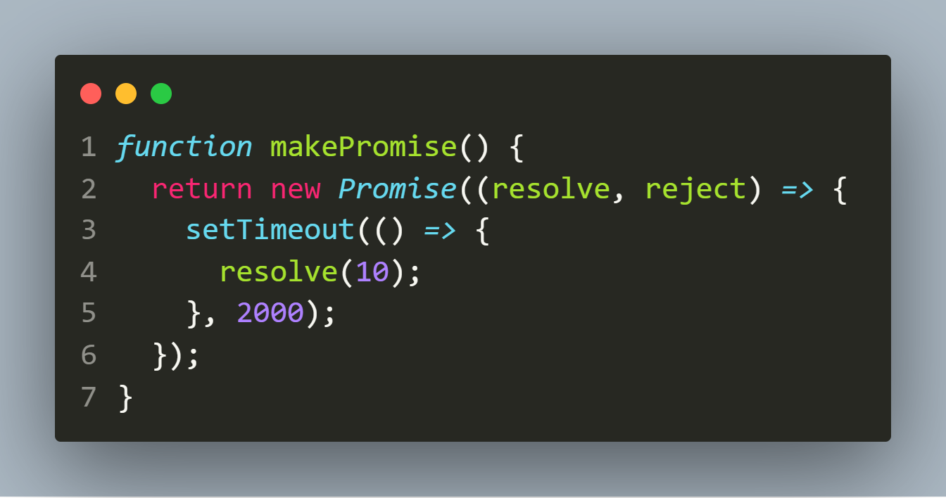
An example
First, create a function that returns a new promise that resolves to the value 10 after 2 seconds:

Slide 15
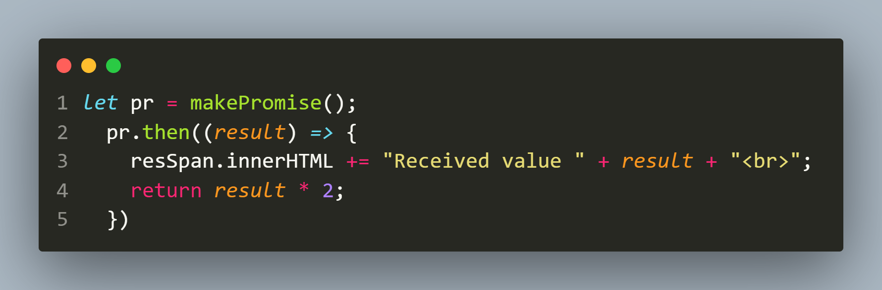
An example
Then, invoke the then() method on the returned promise object:

Slide 16
An example
The callback passed to the then() method executes once the promise is resolved.
In the callback, we displayed the result of the promise and returned a new value: result*2.

Slide 17
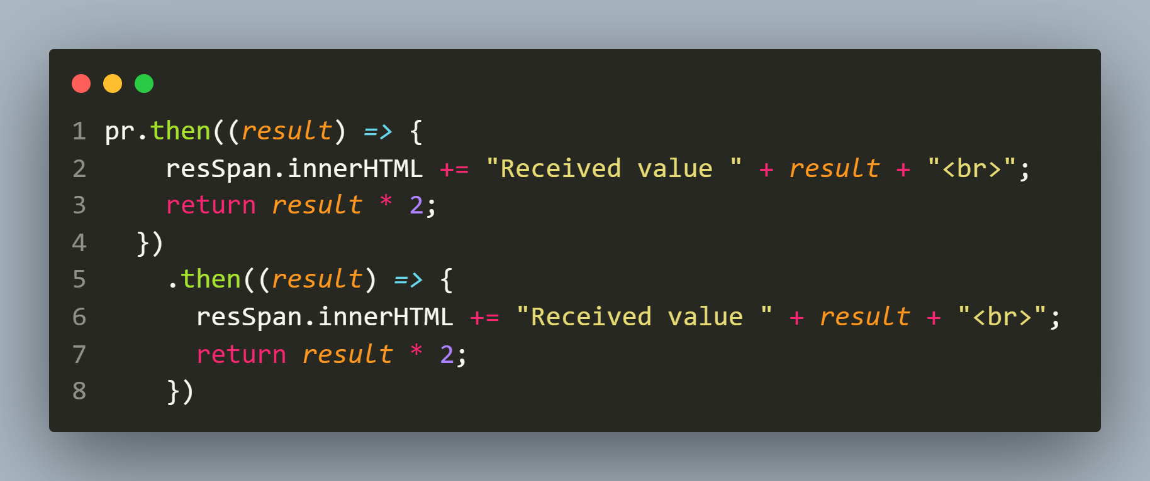
An example
Because the then() method returns a new Promise whose value is resolved to the return value, we can again call the then() method on the returned Promise, as shown:

Slide 18
Returning a promise
When we return a value from the then() method, the then() method converts and returns a new Promise that immediately resolves to the return value.
However if needed we ourselves can return a new promise from the then() method.
To better understand this , attempt the exercise given on the next slide.

Slide 19
Exercise 2
Rewrite the caclulateSquare application so that after getting
square of the original number we again call calculateSquare()
for getting the square of the result i.e. squared value.
Repeat the process thrice

Slide 20
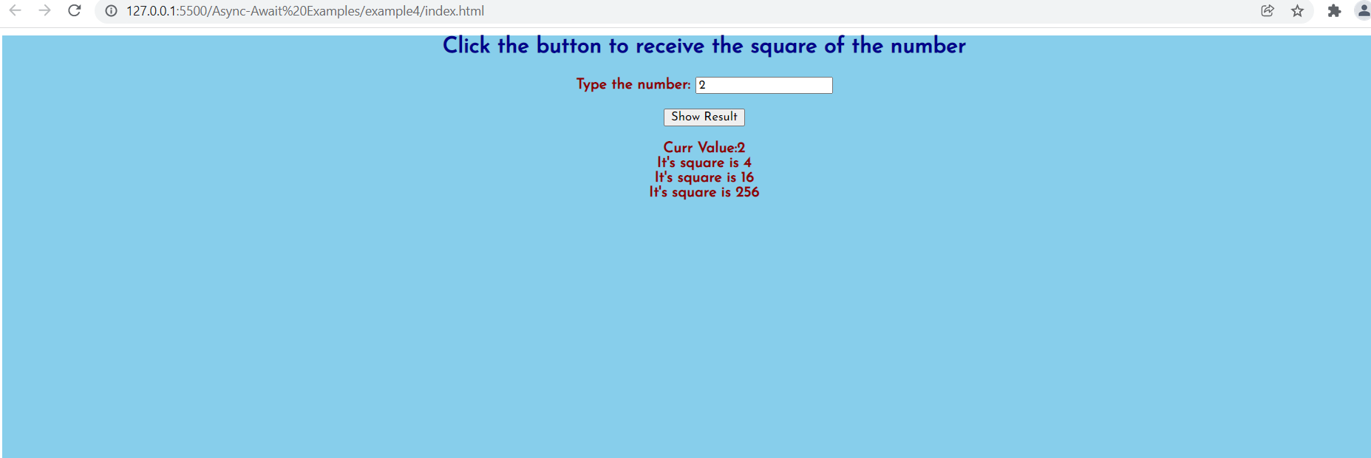
Desired output

Slide 21
Real world example
Suppose that we want to perform the following asynchronous operations in sequence:
Get the user from an api.
Get the services of the selected user from another api.
Calculate the service cost for the user’s services using yet another api.

Slide 22
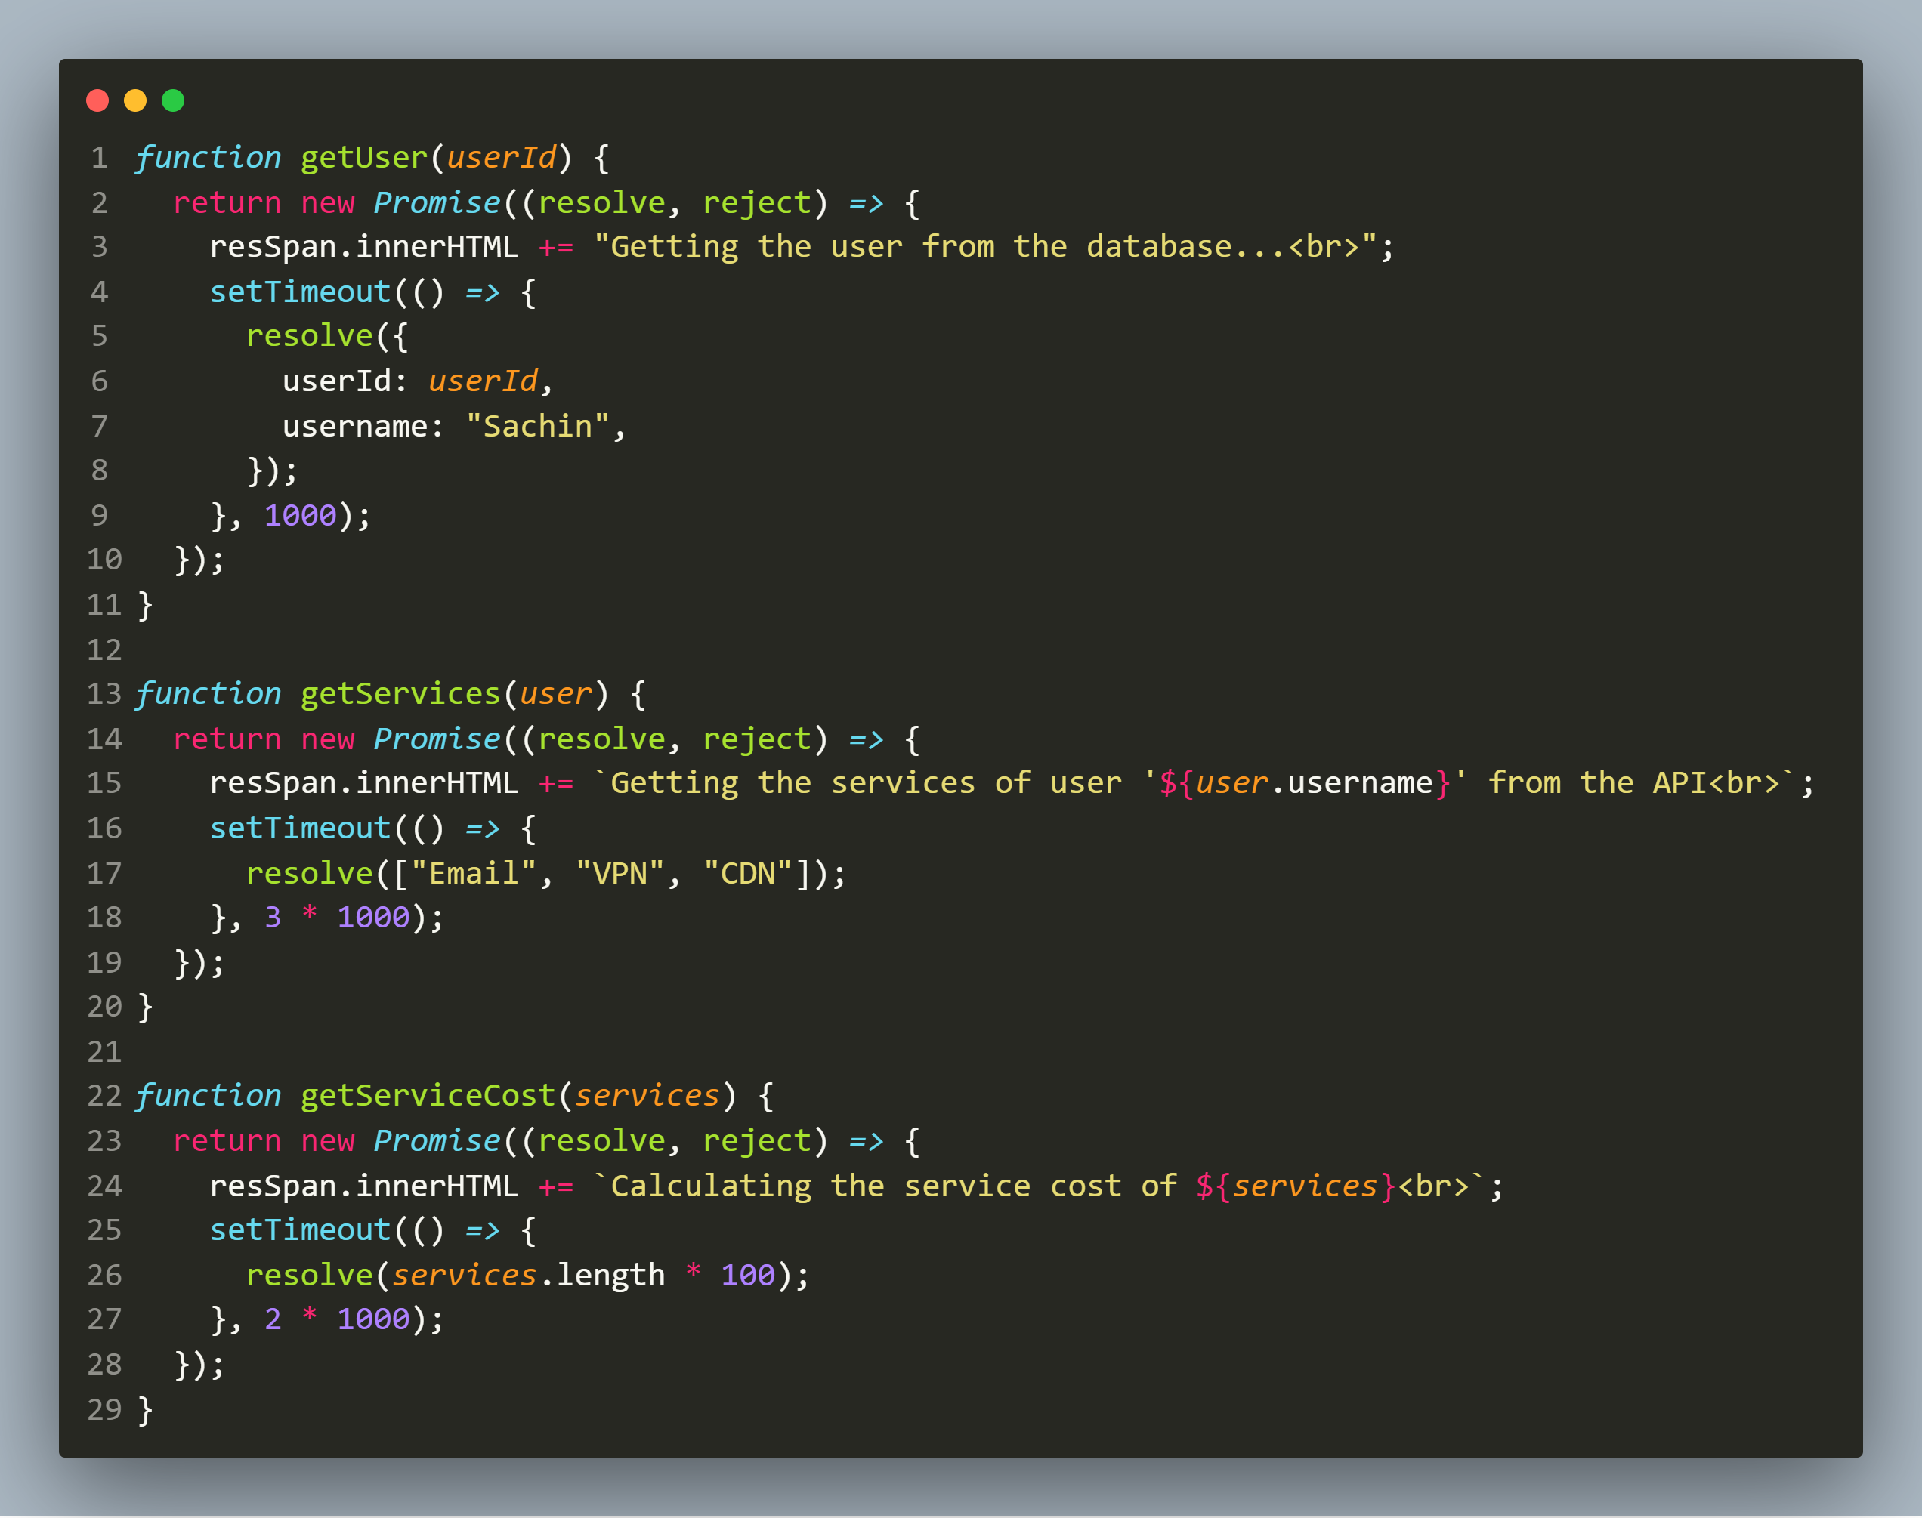
Real world example

Slide 23
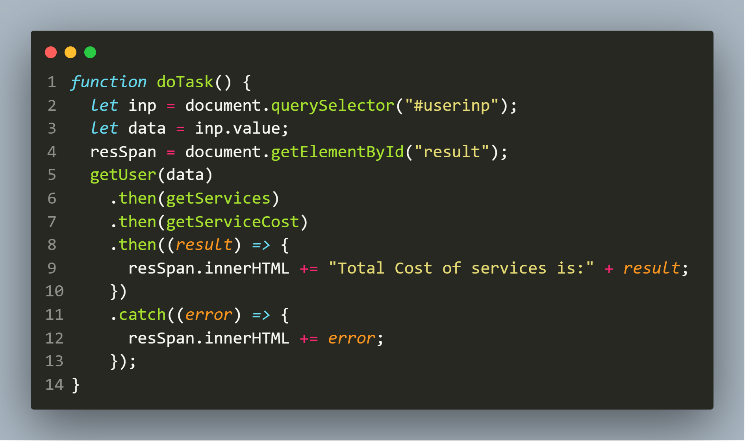
Real world example
Now to call the above functions we can use promise chaining as follows:

Slide 24
Simplifying promise chaining
We can simplify the code of promise chaining using the keywords the async/await .
We know that if a function returns a Promise, we can place the await keyword in front of the function call, as shown in next slide.

Slide 25
Simplifying promise chaining
let result = await f();
The await will wait for the Promise returned from the f() to settle.

Slide 26
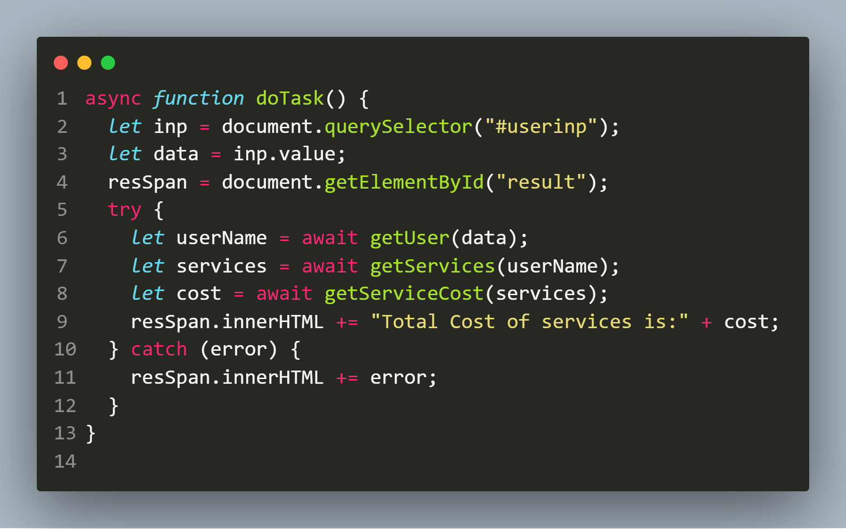
Simplifying promise chaining

Slide 27
Exercise 3
Rewrite the previous caclulateSquare application using
async/await

Slide 28

Thanks!
Any questions?
You can find me at:
Email id: info@scalive.in
Contact no. : +917314853128

